Slide 1
AS & A Level Computer Science
Duration: 2 years
Examination Board: WJEC
’The future awaits……the future is now……’
Contact: Mr O’ Brien
Email: aobrien516@c2ken.net

Slide 2
Overview Requirements: at least B grade in Digital Technology (Programming) at GCSE at least a B grade in Mathematics at GCSE
Our AS/A level Computer Science specification provides learners with an in-depth understanding of the fundamental concepts of computer science and a broad range of flexible and interesting study opportunities.
This specification enables the school to deliver the course in innovative ways. We look to develop students' problem-solving skills, creating elegant ways to program solutions to real life problems.
The course itself comprises of terminal exams at the end of Year 13 & 14. Students also complete a year long programming project.
On successful completion of the course students can access any computing course offered by higher educational institutions.
Contact: Mr O’ Brien
Email: aobrien516@c2ken.net

Slide 3
Overview Requirements: at least B grade in Digital Technology (Programming) at GCSE at least a B grade in Mathematics at GCSE
Computers are widely used in all aspects of business, industry, government, education, leisure and the home. In this increasingly technological age, a study of computer science, and particularly how computers are used in the solution of a variety of problems, is not only valuable to the learners but also essential to the future well-being of the country.
Computer science integrates well with subjects across the curriculum. It demands both logical discipline and imaginative creativity in the selection and design of algorithms and the writing, testing and debugging of programs; it relies on an understanding of the rules of language at a fundamental level; it encourages an awareness of the management and organisation of computer systems; it extends the learners’ horizons beyond the school or college environment in the appreciation of the effects of computer science on society and individuals. For these reasons, computer science is as relevant to a learner studying arts subjects as it is to one studying science subjects.
Contact: Mr O’ Brien
Email: aobrien516@c2ken.net

Slide 4
Careers
Careers: There are many careers options that a person can explore from choosing Computer Science as an option at AS/A Level.
These careers include:
Software Engineering
Data Analysis
Systems Administrator
App developer
Cyber Security
Forensic IT Analyst
…. plus a whole lot more……
Contact: Mr O’ Brien
Email: aobrien516@c2ken.net

Slide 5
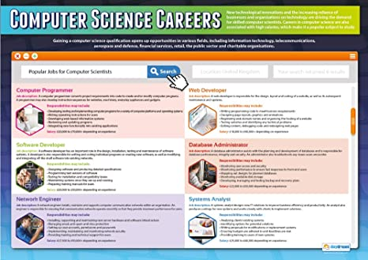

Slide 6
Assessment AS Level
The AS course comprises of a number of theoretical units alongside learning the practical aspects of computer programming. The language that will be used across the course will be Python.
Please see the overview of the AS assessment below:
Contact: Mr O’ Brien
Email: aobrien516@c2ken.net

Slide 7
Assessment A Level
The A Level course comprises three units, two theory and one practical. In the practical unit students must find a client who requires an IT solution to a particular problem. Students need to create a solution to the problem using the Software Development lifecycle
Please see the overview of the A Level assessment below:

Slide 8
For any further enquiries please contact Mr O’ Brien
Email: aobrien516@c2ken.net

